Slide 1
MTP EEPROM updating via i2c Rev-1.3 11/15/2024

Slide 2
MTP product/Configuration Data / code patch Update
IND87451 I2C Slave Interface can be used for ISP (In System Programming). This is a mean to update the Product / Configuration Data and / or Code Patch stored inside the MTP.
To perform the ISP, the I2C Master controller must follow the recommended ISP protocol described in this document.
There are two types files will be loaded to MTP
Product/Configuration data : 1K bytes
Code Patch data : 31K bytes
I2C Master
controller
Product configuration
Code Patch
IND87451
I2C Bus
MTP
I2C Slave
ISP

Slide 3
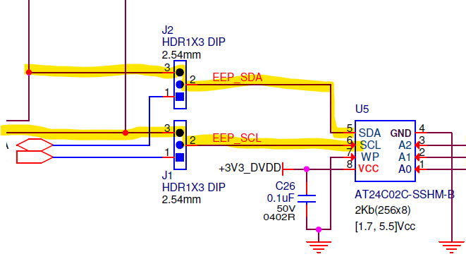
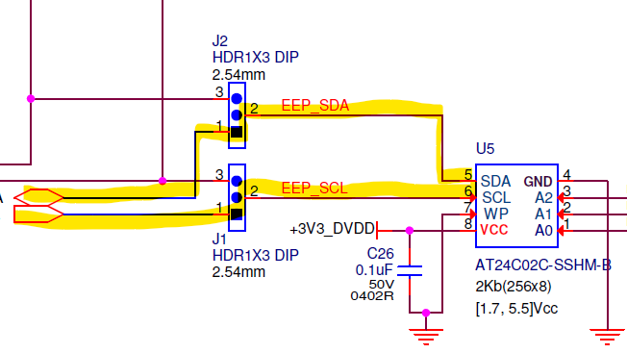
EEPROM Configuration Data
IND87451 I2C master Interface can be used for updating of EERPOM. This is a mean to update the Configuration Data stored inside the EEPROM. And it can also use external i2c master control to update EEPROM
There is only one type file will be loaded to EEPROM
Configuration data : 128 bytes
JUMPs{J1,J2} = {[2-3],[2-3]}
IND87451
I2C Master
controller
configuration
EEPROM
External I2C Master
controller
I2C Bus
I2C Bus
configuration
JUMPs{J1,J2} = {[1-2],[1-2]}

Slide 4

Product / Configuration Data
Total 1024B, can be divided into 2 major blocks – Product and Configuration data:
Product data: 3 Sections
Section #1 - Tracking & Production: It contains the record related FAB production data
Section #2 - DUSR: It contains the Product name, Serial Number, and HDCP keys
Section #3 - Calibration: It records the data calibrated from FAB
Configuration data: 1 Section (#4), contains 3 Records
Config0 record: It contains HW configuration and RX capability settings
DPCD/VSF record: It contains Vendor Specific DPCD settings
LVDS record: It contains LVDSTX configuration settings
And The 2.Configuration data will be stored in both MTP and EEPROM, while the 1.Product data will only be stored in MTP.
1
2

Slide 5
code patch
The main purpose of Code Patch is to modify the incorrect programming in IROM.
The maximum size is 31KB on the top of MTP memory.
IROM currently has no code that needs to be modified, so no code patch data is generated yet.

Slide 6
MTP Updating via I2C over DDC2BI with GPROBE command

Slide 7
Gprobe commands and ddc2bi protocol
The GProbe commands used for ISP has the DDC2Bi3 wrapper. This makes the ISP messages compliant with the DDC2Bi protocol.
The DDC2Bi3 wrapper for ISP through the I2C Interface has the same message structure as the standard DDC2Bi3 used over the HDMI DDC interface.
Consists of following message fields: DDC Destination, DDC Source, Length, VCP Prefix, Message and Checksum
The VCP prefix consists of two parts:
VCP command code 0xC2: This particular code is undefined in the official DDC2Bi standard and is available for custom commands. Indie’s DDC2Bi3 wrapper uses the VCP command code 0xC2 and further expands it into the command page with the sub-commands specified in the remainder of the message.
The command page: This is made up of two bytes following the VCP command code 0xC2. Indie reserves the command page 0x0000 for its own commands. Indie can assign individual command pages to its customers upon request, if customers wish to implement their own command sets for specific applications.

Slide 8
DDC2Bi3 wrapper for ISP through the I2C Interface
Name | Length | Value | Comment
DDC Destination | 1 | 0x6E
DDC Source | 1 | 0x51 | Please note that length of VCP Prefix + Message can’t exceed 127
Length | 1 | 0x80 | Length of VCP prefix + Message
VCP Prefix | 3 | 0xC2 0x00 0x00
Message | variable
Checksum | 1 | XOR of all previous bytes | Byte chksum = 0 For(i=0;i<buffersz;i++) chksum ^= buf[i];

Slide 9
Gprobe command loads 1KB Product / Configuration DATA into Sirius
First command (0x10) writes Product/Configuration data (1KB) MTP SRAM in Sirius, noted as “CMD1”
CMD1
GProbe Command
0x10 = MTPWrite
DDC2BI Header
S
0x37
Dst
0x51
Src
0x85
Length
0xC2 0x00 0x00
VCP Prefix
0x03 0x10
Message
0x6B
Chksum
Address (0x13000~0x133FF for Product/Configuration)
Count (Maximum: 0x400=1KB per message)
GProbe
MTPWrite
Command
0x00 0x01 0x30 0x00
Address = 0x13000
0x00 0x00 0x04 0x00
Count = 0x400
Message
Payload, Size is 1024B
CRC16
0x00 0x00 0x17 0xC2
CRC16 = 0x17C2
P

Slide 10
Gprobe command loads 1KB Product/Configuration DATA into Sirius (conti.)
Second command (0x07) that updates Product/Configuration Data from MTP SRAM to MTP (in Sector 3), noted as “CMD2”
CMD2
GProbe Command
0x07 = MTPUpdate
DDC2BI Header
S
0x37
Dst
0x51
Src
0x85
Length
0xC2 0x00 0x00
VCP Prefix
0x03 0x07
Message
0x7C
Chksum
Message for executing
0x00 0x01 0xFF
P
Executes CMD1 and CMD2 to complete the Product/Configuration Data update into MTP
CMD1
CMD2

Slide 11
Gprobe command loads 31KB code patch DATA into Sirius
First command (0x10) that writes Code Patch data (max 31KB) into MTP SRAM in Sirius, noted as “CMD3-X”.
As payload size is up to 1024B for each command and size of the Code Patch is varied (between 0~31KB), will need to divide into multiple MTPWrite commands to complete. Where X = Code Patch size / 1024, and the size of the last payload, X+1, = Code Patch size % 1024 (if non-zero)
CMD3-1
CMD3-2
CMD3-3
…..
CMD3-X
CMD3-(X+1)
GProbe Command
0x10 = MTPWrite
DDC2BI Header
S
0x37
Dst
0x51
Src
0x85
Length
0xC2 0x00 0x00
VCP Prefix
0x03 0x10
Message
0x6B
Chksum
Address (0x300000~0x307FFF for Code Patch)
Count (Maximum: 0x400=1KB per message)
GProbe
MTPWrite
Command
0x00 0x30 (0x00 0x00 + 0x400 * X)
Address = 0x300000
0x00 0x00 0x04 0x00
Count = 0x400
Message
Payload, Size is 1024B
CRC16
0x00 0x00 0x17 0xC2
CRC16 = 0x17C2
P

Slide 12
Gprobe command loads 31KB code patch DATA into Sirius (conti.)
Second command (0x07) that updates Code Patch Data from MTP SRAM to MTP Sector 0-3, noted as “CMD4”
CMD4
GProbe Command
0x07 = MTPUpdate
DDC2BI Header
S
0x37
Dst
0x51
Src
0x85
Length
0xC2 0x00 0x00
VCP Prefix
0x03 0x07
Message
0x7C
Chksum
Message for executing
0x00 0x01 0xFF
P
Executes the CMD3-1~CMD3-(X+1) and CMD4 to complete the Code Patch Data update into MTP
CMD3-1
CMD3-2
CMD3-3
…..
CMD3-X
CMD3-(X+1)
CMD4

Slide 13
Binary files convert to the sequence of I2C controller with Python

Slide 14
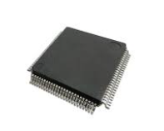

Original binary FILES
indie will prepare Product/Configuration(1KB) and Code Patch(XKB, max 31KB) binary files for Tesla and ATE to do MTP updating
356B bin
ATE
Product data
128B bin
Configuration data
Tesla
XKB bin
Code Patch

Slide 15
Python script to generate files for I2C update sequence(MTP/EEPROM)
Convert Product/Configuration Data or Code Patch binary to files for ISP
Install Python (v3.12.6)
Execute Python script :
Python modify_binary_file.py [Type] [InputBIN] [OutputBIN] [OutputXML][Slaveaddr]
Type:
codepatch: Input binary contains Code Patch
mtpfull: Input binary contains all Product related records (Tracking & Production / DUSR / Calibration Data in Sections 1-3) and Configuration Data related records (CONFIG0 / DPCD_VSF / LVDS_CONFIG in Section 4)
mtpproduct: Input binary contains only Product related records
mtpconfig: Input binary contains only Configuration Data related records
eeprom: Input binary contains only Configuration Data related records for EPROM updates
InputBIN: Original Product / Configuration Data or Code Patch binary array file
OutputBIN: Converted binary array file for I2C update sequence. It can be used in script(s) or batch(es) for customer’s I2C master device. It is currently not used, but for possible usage in the future.
OutputXML: To run in Total Phase Control Center Batch Mode with Aardvark I2C/SPI Host Adapter
Slaveaddr To input EEPROM’s slave address(default value is 0x54)
NOTE: Will not support the individual Configuration Data record update to MTP. All the 3 Configuration Data records (CONFIG0 / DPCD_VSF / LVDS_CONFIG) shall be combined in one binary and programmed together to avoid number of MTP programming times and risks to accidently corrupt the Product related records.

Slide 16
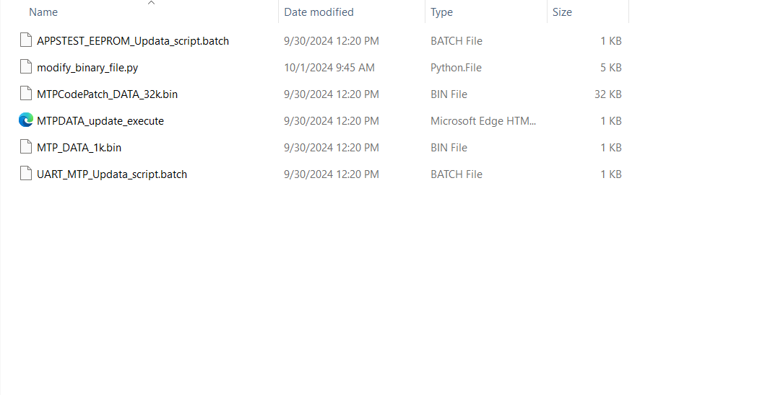
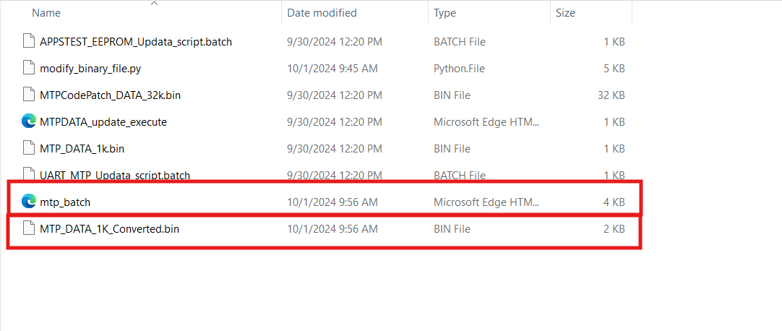
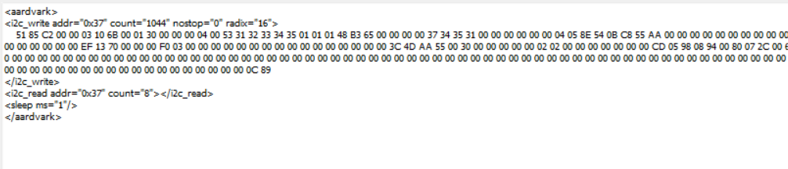
Example of sequence to update 1kb DATA to MTP – 1 (case: Product + Configuration DATA)
Run Python script from Windows Command Prompt to generated converted files:
> Python modify_binary_file.py mtpfull MTP_DATA_1K.bin MTP_DATA_1K_Converted.bin mtp_batch.xml
After executing python
mtp_batch.xml

Slide 17

Example of sequence to update 1kb DATA to MTP – 1-1 (case: Product + Configuration DATA)
MTP_DATA_1K.bin
MTP_DATA_1K_Converted.bin
DDC2BI Header
MTP data
After executing python

Slide 18
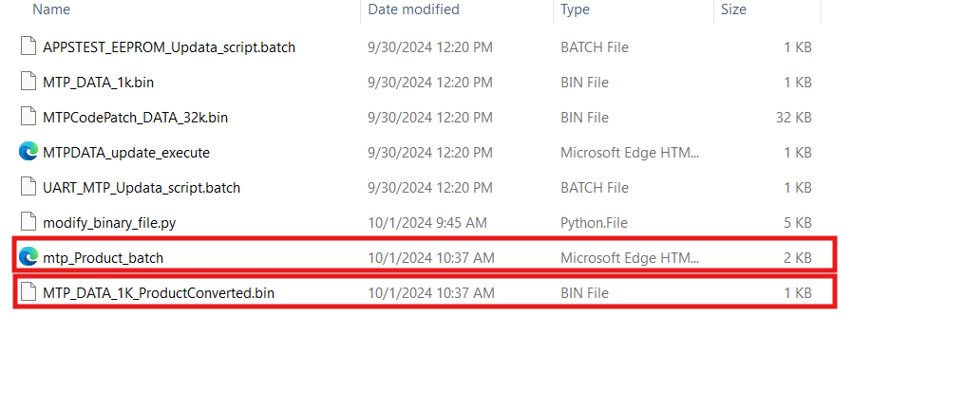
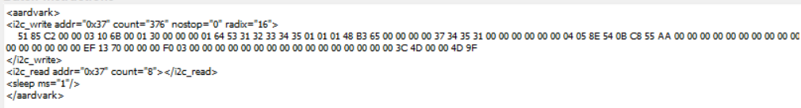
Example of sequence to update 1kb DATA to MTP – 1-2 (case: product DATA only)
Run Python script from Windows Command Prompt to generated converted files separately:
> Python modify_binary_file.py mtpproduct MTP_DATA_1K.bin MTP_DATA_1K_ProductConverted.bin mtp_Product_batch.xml
After executing python
mtp_Product_batch.xml

Slide 19

Example of sequence to update 1kb DATA to MTP – 1-3 (case: Product DATA only)
MTP_DATA_1K.bin
MTP_DATA_1K_ProductConverted.bin
DDC2BI Header
MTP product data
After executing python
CRC16 for DDC2Bi

Slide 20
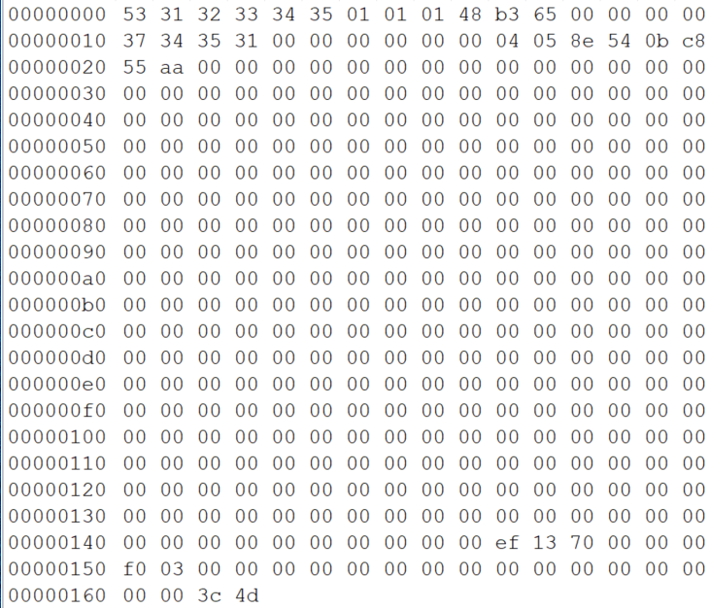
Example of sequence to update 1kb DATA to MTP – 1-4 (case: Product DATA only)
MTP_DATA_1K.bin
mtpproduct.bin
After executing python

Slide 21
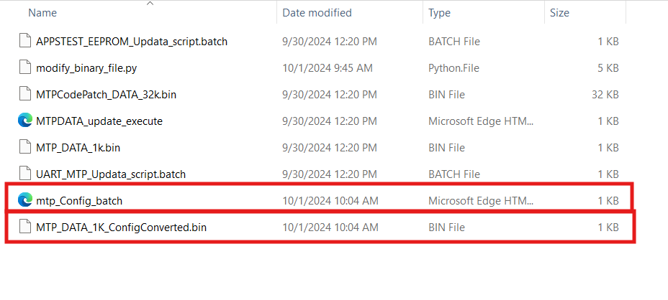
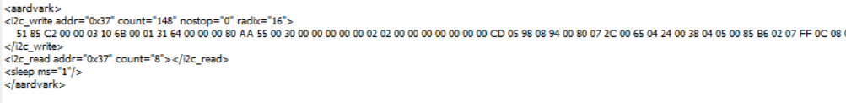
Example of sequence to update 1kb DATA to MTP – 1-5(case: Configuration DATA only)
Run Python script from Windows Command Prompt to generated converted files separately:
> Python modify_binary_file.py mtpconfig MTP_DATA_1K.bin MTP_DATA_1K_ConfigConverted.bin mtp_Config_batch.xml
After executing python
mtp_Config_batch.xml

Slide 22
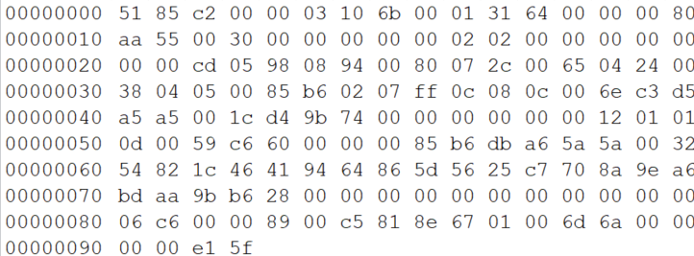
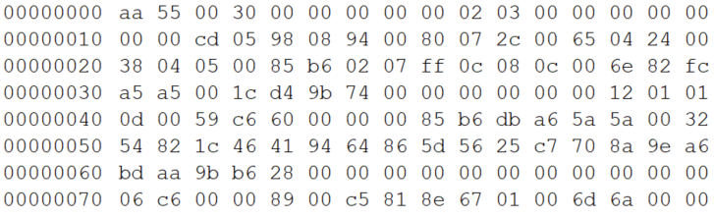
Example of sequence to update 1kb DATA to MTP – 1-6 (case: Configuration DATA only)
MTP_DATA_1K.bin
MTP_DATA_1K_ConfigConverted.bin
DDC2BI Header
MTP configuration data
CRC16 for DDC2Bi
After executing python
mtpconfig.bin
MTP configuration data

Slide 23
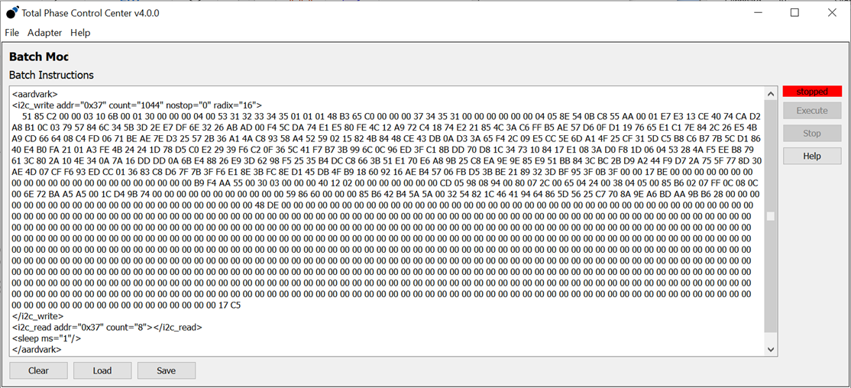
Example of sequence to update 1kb DATA to MTP – 2
If use Aardvark to update, load the mtp_batch.xml file from Total Phase Control Center → Adapter → Batch Mode. Then hit “Execute” button after loaded.
NOTE: This step only writes the binary into Sirius’s SRAM memory for MTP. Yet updating to MTP.

Slide 24
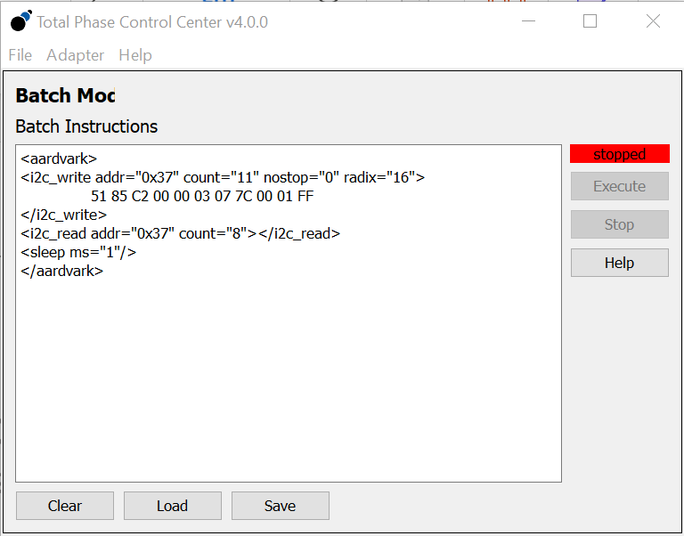
Example of sequence to update 1kb DATA to MTP – 3
After writing to Sirius internal memory is done, load the MTPDATA_update_execute.xml file from Total Phase Control Center → Adapter → Batch Mode. Then hit “Execute” button to start updating to MTP (from SRAM).

Slide 25
EEPROM Updating via I2C

Slide 26
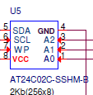
EEPROM hardware feature
The EEPROM has three hardware detection PINs, A0, A1, and A2 in the picture below. They can decide the i2c slave address of EEPROM
PINs{A2,A1,A0} | i2c slave address(7-bit)
{0,0,1} | 0x51
{0,1,0} | 0x52
{0,1,1} | 0x53
{1,0,0} | 0x54
{1,0,1} | 0x55
{1,1,0} | 0x56
{1,1,1} | 0x57
The EEPROM has a data transfer limitation: a 1ms delay must be added after every 8-byte(as payload size) of I2C transfer

Slide 27
I2c sequence loads 128B configuration DATA into EEPROM
I2C protocol write:
I2C Write
Command
S
Slave address(7bit)
+0 for write bit
Reg. address
(Byte *)Data
P
I2C Read
Command
S
Slave address(7bit)
+0 for writing bit
Reg. address
Slave address(7bit)
+1 for reading bit
(Byte *) Data
P
For example:
PINs{A2,A1,A0} = {1,0,0} → slave address = 0x54 → write command : 0xA8
S
0xA8
0x00
0xAA 0x55 0x00 0x30 0x00 …
P
PINs{A2,A1,A0} = {1,0,0} → slave address = 0x54 → read command : 0xA9
S
0xA8
0x00
0xA9
0xAA 0x55 0x00 0x30 0x00 …
P

Slide 28
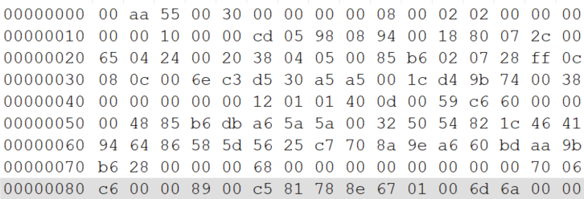
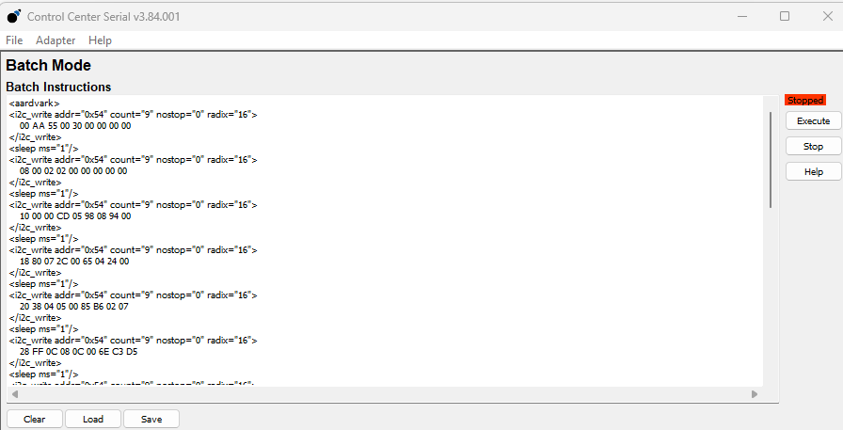
Example of sequence to update EERPOM via external i2c master (AADVARK)
MTP_DATA_1K.bin
Continue Configuration DATA update on page-21. Run Python script from Windows Command Prompt to generate aadvark batch file:
Python modify_binary_file.py eeprom MTP_DATA_1K.bin EEP_DATA_1K_ConfigConverted.bin eep_Config_batch.xml 0x54
The parameter is EEPROM’s slave address
EEP_DATA_1K_ConfigConverted.bin
eep_Config_batch.xml

Slide 29
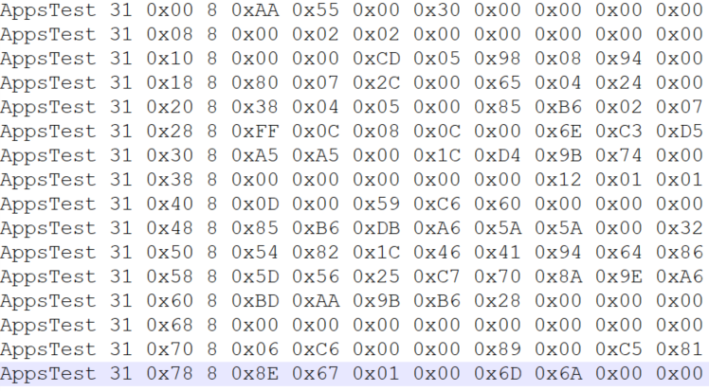
Example of sequence to update EERPOM via SIRIUS i2c master (Appstest)
Run Python script from Windows Command Prompt to generate AppsTest batch file:
Python modify_binary_file.py eeprom MTP_DATA_1K.bin EEP_DATA_1K_ConfigConverted.bin eep_Config.batch
Note: This example is for indie’s Sirius EV board that has UART enabled to execute AppsTest batch from indie’s Windows GProbe tool.
APPSTEST_EEPROM_Updata_script.batch
eepconfig.bin

Slide 30
EEPROM Updating via HostInterface

Slide 31
The Virtual registers(VR) with eeprom
Offset/data register
Update register
0x06
Bit | Bit name | Function
7:0 | CONFIG0_PL_OFF | Payload Offset for CONFIG0 Record
15:8 | CONFIG0_PL_BYTE | 8bit data for offset CONFIG0 Payload
0x07
Bit | Bit name | Function
0 | CONFIG0_UPDATE_DONE | Sirius will Calculate CRC, create Record and program EEPROM locations for this record when this bit is set.
1 | CONFIG0_UPDATE_EEPROM_DONE | EEPROM update is done with HI interrupt. Host can restart Sirius and use the Configuration Data from EEPROM to initialize the system.
0x08
Bit | Bit name | Function
7:0 | DPCD_VSF_PL_OFF | Payload Offset for DPCD VSF Record
15:8 | DPCD_VSF_BYTE | 8bit data for offset DPCD VSF Payload
0x09
Bit | Bit name | Function
0 | DPCD_VSF_UPDATE_DONE | Sirius will Calculate CRC, create Record and program EEPROM locations for this record when this bit is set.
1 | DPCD_VSF_UPDATE_EEPROM_DONE | EEPROM update is done with HI interrupt. Host can restart Sirius and use the Configuration Data from EEPROM to initialize the system.
0x0A
Bit | Bit name | Function
7:0 | LVDS_CONFIG_PL_OFF | Payload Offset for LVDS CONFIG Record
15:8 | LVDS_CONFIG_PL_BYTE | 8bit data for offset LVDS CONFIG Payload
0x0B
Bit | Bit name | Function
0 | LVDS_CONFIG_UPDATE_DONE | Sirius will Calculate CRC, create Record and program EEPROM locations for this record when this bit is set.
1 | LVDS_CONFIG_UPDATE_EEPROM_DONE | EEPROM update is done with HI interrupt. Host can restart Sirius and use the Configuration Data from EEPROM to initialize the system.

Slide 32
Update steps – for an example : change of LVDS config byte1 to be 0x33
1. Use VR 0x0A to update the value of LVDS config BYTE1
CMD1
VR address 0x0A
Payload byte 0x33
S
0xE0
0x0A 0x01 0x33
P
Payload offset 0x01
HostInterfase slave address 0xE0 for writing, 0xE1 for reading --> 7bit : 0x70
2. Use VR 0x0B to perform calculation of CRC16 and write to EEPROM
CMD2
VR address 0x0B
S
0xE0
0x0B 0x01 0x00
P
LVDS_CONFIG_UPDATE_DONE = 1
HostInterfase slave address 0xE0 for writing, 0xE1 for reading --> 7bit : 0x70

Slide 33
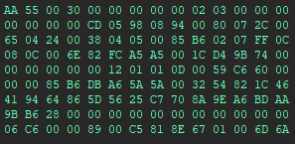
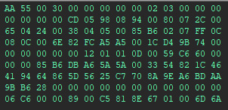
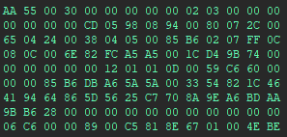
Update steps – for an example : change of LVDS config byte1 to be 0x33
1. Check the status of VR 0x0B -- If LVDS_CONFIG_UPDATE_EEPROM_DONE is set to 1, it means that the new value and the calculated new CRC16 are updated to the EEPROM.
CMD3
VR address 0x0B
S
0xE0
0x0B
0xE1
0x02 0x00
P
HostInterfase slave address 0xE0 for writing, 0xE1 for reading --> 7bit : 0x70
LVDS_CONFIG_UPDATE_EEPROM_DONE=1
VR 0x0B =0x0000
VR 0x0B =0x0002
CMD1
CMD2

Slide 34
Appendix
Calculation of CRC 16

Slide 35
Calculation of CRC 16(Python code)
def calculate_crc16(Buf: bytes, W_len: int) -> int:
Accum = 0x1021
PolDiv = 0x1021
for j in range(W_len):
DataIn = Buf[j]
for _ in range(8):
flag = DataIn ^ (Accum >> 8)
Accum <<= 1
if flag & 0x80:
Accum ^= PolDiv
DataIn <<= 1
Accum &= 0xFFFF
return Accum

